Slide 1
HomeFix
Presented by: Team 4685
Mayesha Fahmida
Mashiyat Jahin
Iman Hamby
Atif Tausif
Cuiwen Wu
Guowei Zhao

Slide 2
Introduction
Platform to hire home service professionals
Supports plumbing, electrical, and more
Users can book, pay, and review services
Designed as a real-world scalable system

Slide 3
Tech Stack
Frontend: React (Vite)
Backend: Node.js + Express
Database: MySQL
Tools: VS Code, Workbench, GitHub

Slide 4
Business Model
Commission charged per completed appointment
Wallet-based payment system
Provider payouts after commission deduction
Scalable model for multiple services

Slide 5
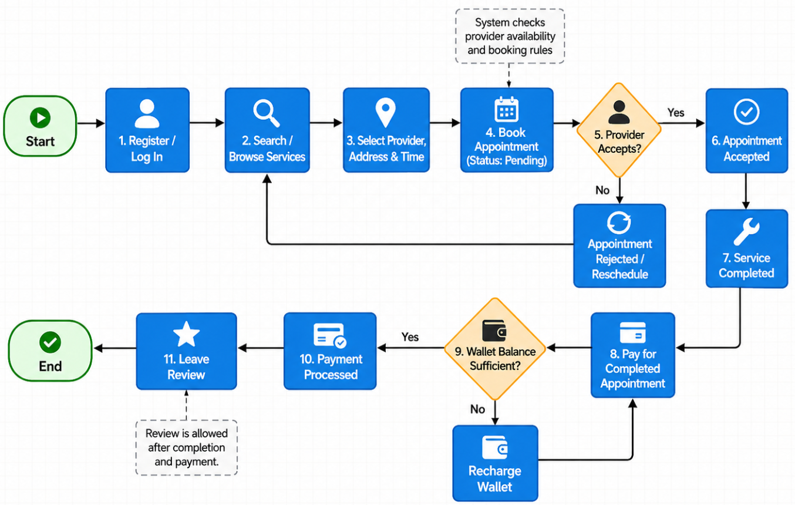
Receiver Journey

Slide 6
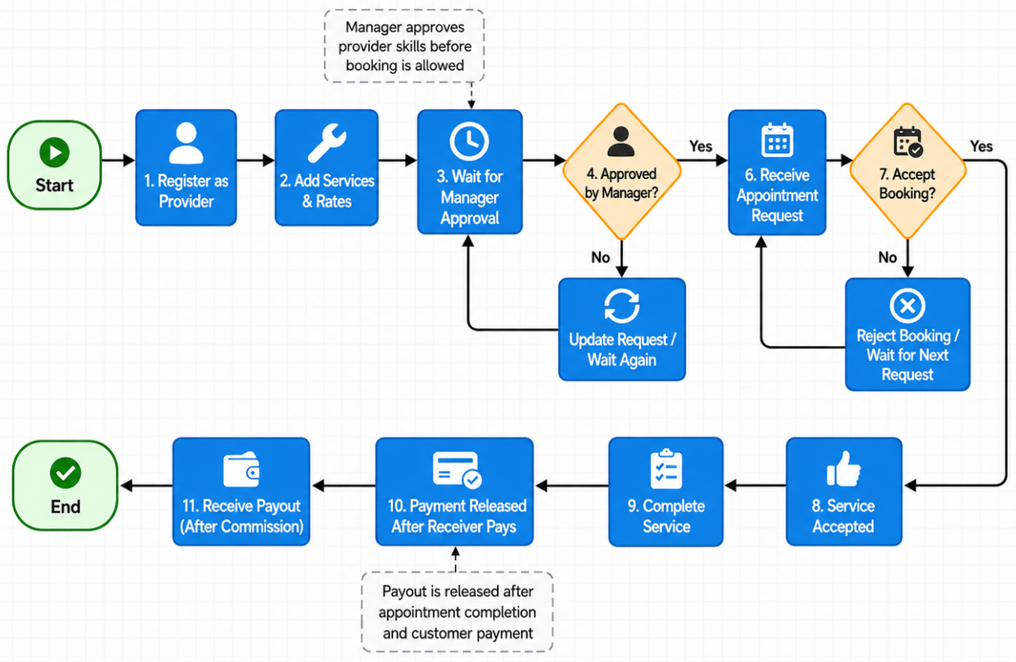
Provider Journey

Slide 7
Live Demo

Slide 8
Stored Procedures
Procedure 1: Recharge Wallet (CALL sp_receiver_recharge(1, 50);)
Adds $50 to receiver’s wallet
Updates wallet balance instantly
Procedure 2: Process Payment (CALL sp_create_payment_for_completed_appointment(1, 0.15);)
Processes payment after appointment completion
Deducts from receiver wallet
Calculates commission and provider payout

Slide 9
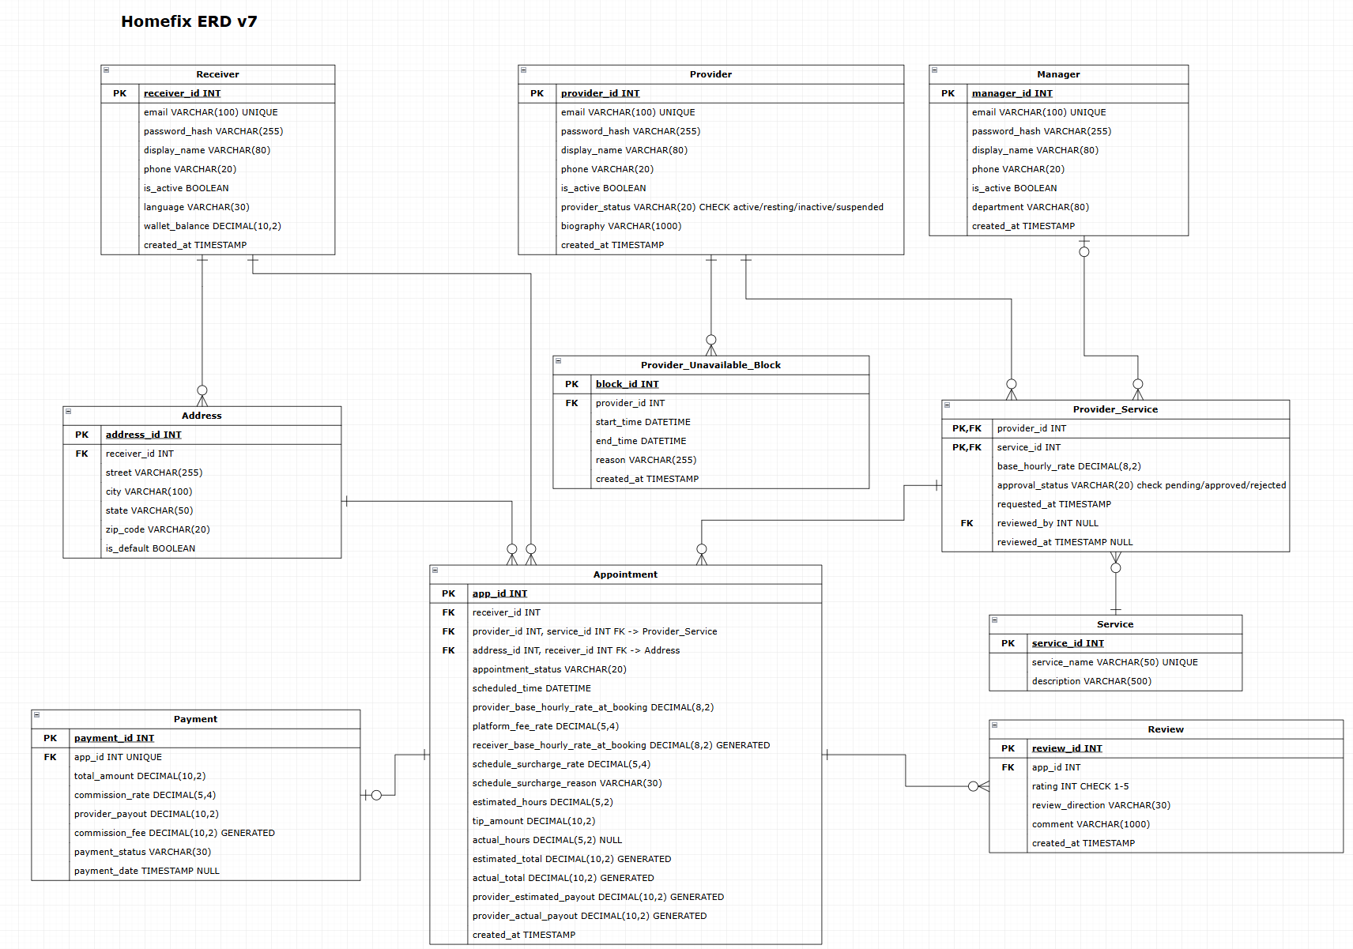

Slide 10
Business Rules and Constraints
Providers must be approved before booking
No overlapping appointments allowed
Unavailable time blocks enforced
Payments only after completed services
Rating must be between 1–5

Slide 11
Revenue Model
How HomeFix earns money:
Commission on completed appointments
Receivers pay through wallet
Platform deducts commission
Provider receives remaining amount
Example: Total payment-$100
Commission (15%)- $15
Provider gets $85

Slide 12
Pricing and Payment
Cost Calculation:
Based on provider hourly rate
Adjusted by schedule surcharge
Includes optional tip
Surcharge Rules:
No surcharge during normal hours (Monday-Friday, 8:00 am- 5:00pm)
20% surcharge after-hours
10% surcharge on weekends
30% surcharge on weekend after-hours

Slide 13
Takeaways
Better understanding of relational databases
Connected application to a MySQL database
Used triggers and procedures
Learned Express and Docker

Slide 14
Thank you!

